Slide 1

Detection of Path-holes using Image Processing and IOT
Team Members:
Saravanan S (913119104088)
Buvisuriya B (913119104014)
Sree Aakash K R (913119104101)
Yoha Venkatesh R S(913119104122)
Team Number: 14
Supervisor Name: Mrs.C.B.Selva Lakshmi M.E,M.B.A
Assistant professor,
Department of CSE
Department of Computer Science and Engineering Final Review
Velammal College of Engineering and Technology 22- 05-2023

Slide 2
Contents
Introduction
Scope and Objective
Literature Survey of Project
Existing system
Problem Definition
Proposed System
System Architecture
List of Modules
Description of the Modules
Results and Discussion(Output Screenshot)
Performance Analysis
Conclusion and Future Work
References
Paper Publication(Proof)
Department of Computer Science and Engineering Final Review
Velammal College of Engineering and Technology 22- 05-2023

Slide 3
Introduction
Roads are crucial for providing transportation and connecting people and enhances business and economy of a country.
The primary objective of this system is to detect the potholes present on the road through deep learning approach which helps to automate the task of detecting potholes.
Department of Computer Science and Engineering Final Review
Velammal College of Engineering and Technology 22- 05-2023

Slide 4
Scope and Objective
Road Safety:
Potholes can be a significant road hazard. Pothole detection systems can help prevent accidents by identifying potholes on the road surface and alerting drivers in real-time.
Road Maintenance:
Pothole detection systems can help local authorities identify potholes and prioritize repairs based on the severity of the damage.
Autonomous vehicle:
Autonomous vehicles rely on accurate and up-to-date road data to navigate safely.
Department of Computer Science and Engineering Final Review
Velammal College of Engineering and Technology 22- 05-2023

Slide 5
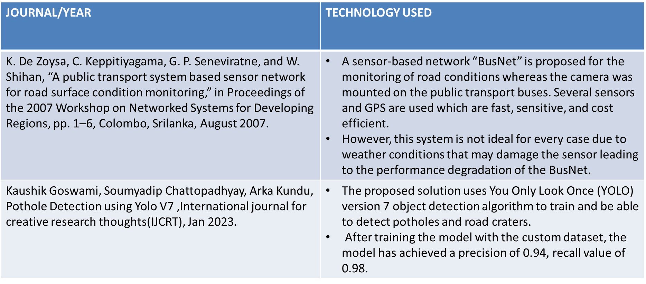
Literature Survey
Department of Computer Science and Engineering Final Review
Velammal College of Engineering and Technology 22- 05-2023

Slide 6
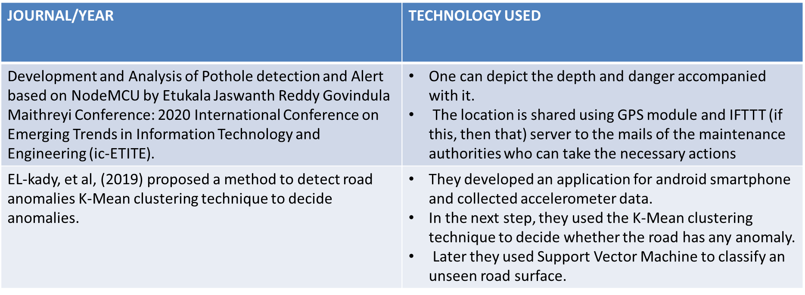
Literature Survey
Department of Computer Science and Engineering Final Review
Velammal College of Engineering and Technology 22- 05-2023

Slide 7
Existing System
Using Ultrasonic Sensors, Accelerometers
3d Reconstruction methods
Image processing
Department of Computer Science and Engineering Final Review
Velammal College of Engineering and Technology 22- 05-2023

Slide 8
Problem Statement
The current methods of pothole detection predominantly rely on manual inspections by road authorities, which are often time-consuming, expensive, and inefficient.
Therefore, there is a need for an automated pothole detection system that can accurately and efficiently identify the presence and location of potholes on roads.
Department of Computer Science and Engineering Final Review
Velammal College of Engineering and Technology 22- 05-2023

Slide 9
Proposed System
This System proposes a modified VGG16 network to detect potholes in real time environment including YOLO-v4 and faster RCNN with different Backbones.
The detected pothole is stored in a database along with its gps coordinates for identification of potholes.
Using supervised machine learning, we train an object detection model using an image dataset containing potholes.
Department of Computer Science and Engineering Final Review
Velammal College of Engineering and Technology 22- 05-2023

Slide 10
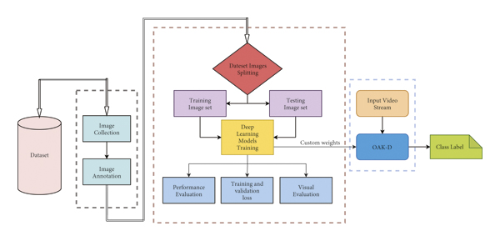
System Architecture
Department of Computer Science and Engineering Final Review
Velammal College of Engineering and Technology 22- 05-2023

Slide 11
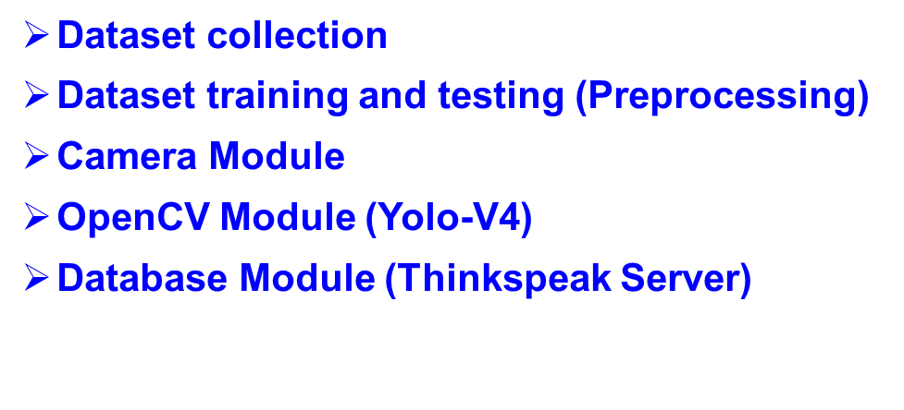
List of Modules
Department of Computer Science and Engineering Final Review
Velammal College of Engineering and Technology 22- 05-2023

Slide 12
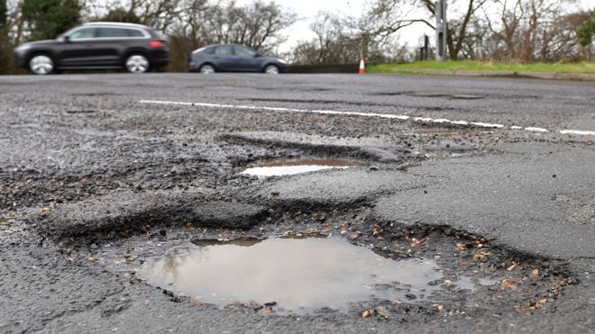
Module Description
Dataset Collection
Collecting the path-hole images from website and capturing real-time scenarios.
Department of Computer Science and Engineering Final Review
Velammal College of Engineering and Technology 22- 05-2023

Slide 13
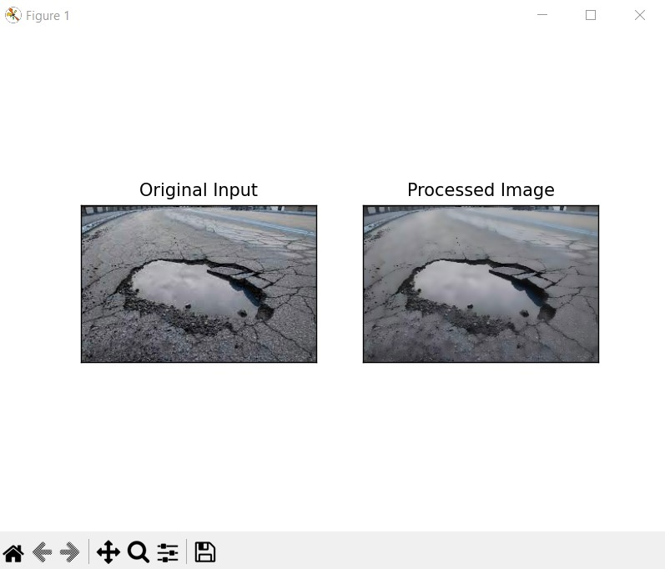
Module Description
Dataset Pre-processing
RCNN method is used to train the data.
Data accuracy, Data precision, Training loss can be evaluated during this phase.
Department of Computer Science and Engineering Final Review
Velammal College of Engineering and Technology 22- 05-2023

Slide 14
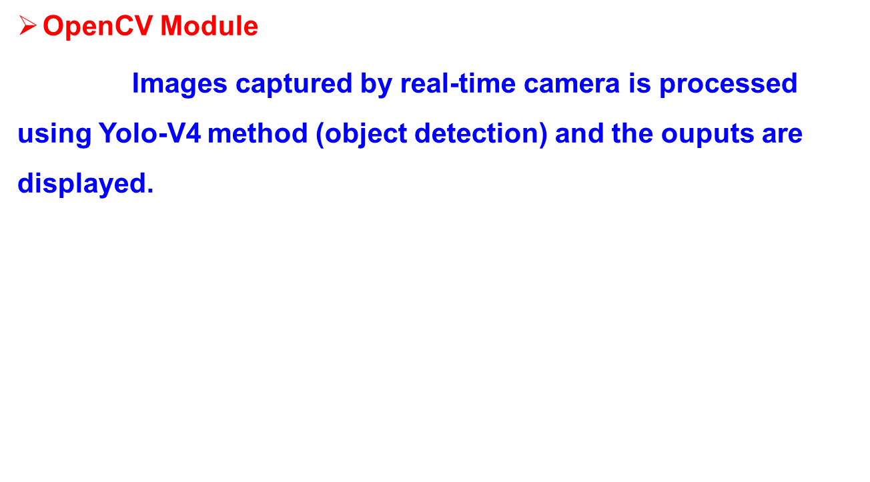
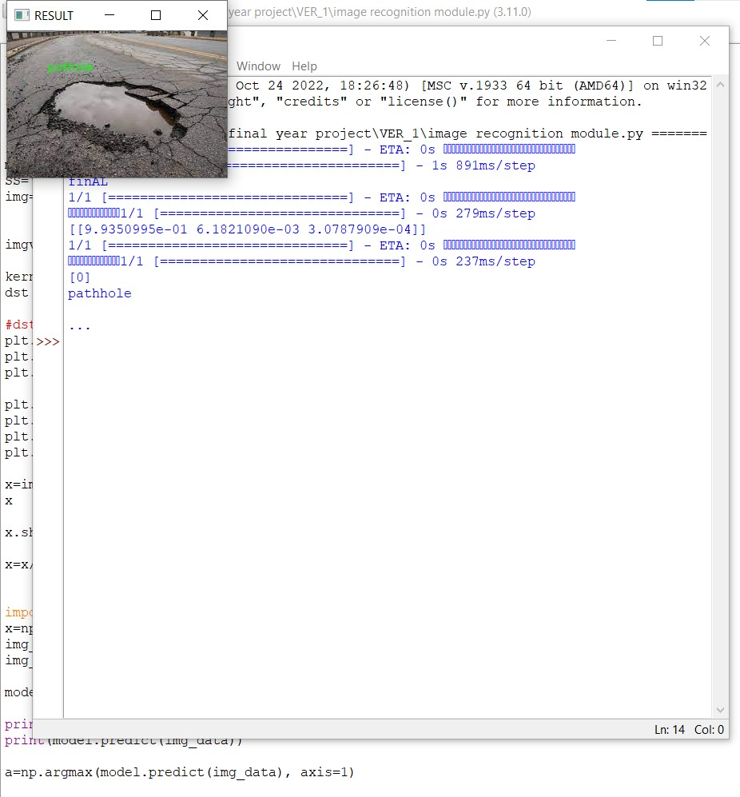
Module Description
Department of Computer Science and Engineering Final Review
Velammal College of Engineering and Technology 22- 05-2023

Slide 15
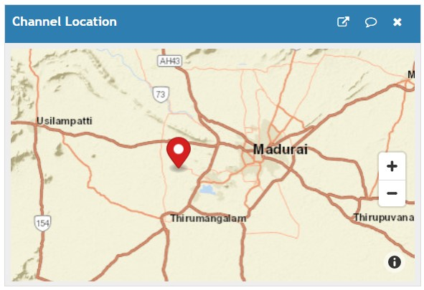
Module Description
Database Module:
The reported potholes are sent to the thingspeak server database so that drivers can know the potholes present on the road.
Department of Computer Science and Engineering Final Review
Velammal College of Engineering and Technology 22- 05-2023

Slide 16
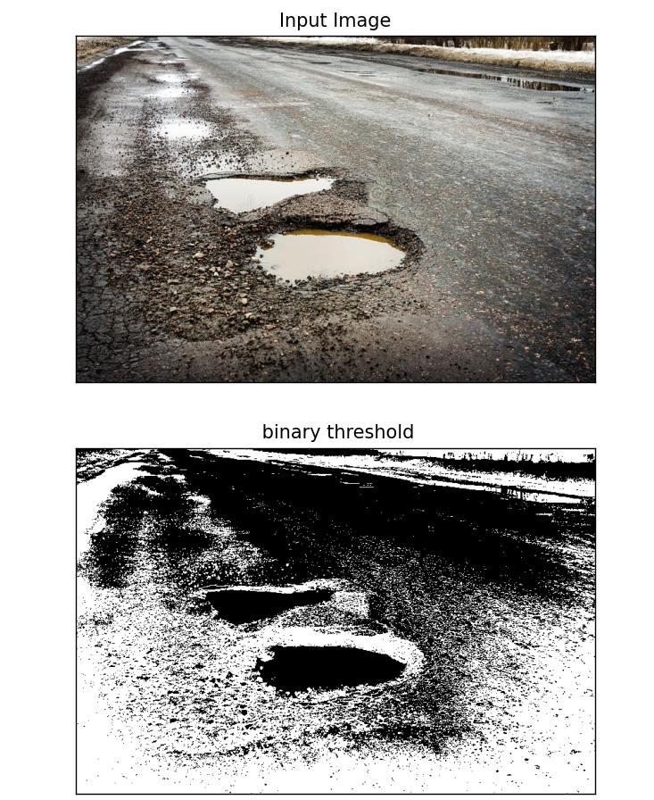
Results and Description
Tiny-YOLOv4 is considered the best model to implement for real-time path-hole detection systems as its inference time is 4.8 ms with mean average precision 90%
Department of Computer Science and Engineering Final Review
Velammal College of Engineering and Technology 22- 05-2023

Slide 17
Results and Description
Department of Computer Science and Engineering Final Review
Velammal College of Engineering and Technology 22- 05-2023

Slide 18
Results and Description
The input image is converted into computer understandable format for processing. After processing, the output will be displayed as pothole if it detects as shown above.
Department of Computer Science and Engineering Final Review
Velammal College of Engineering and Technology 22- 05-2023

Slide 19
Performance Analysis
The model has an accuracy of 89% and training loss of 0.6.
It takes lot of time for training the dataset.
Inference time 65.9ms for CPU inference.
Department of Computer Science and Engineering Final Review
Velammal College of Engineering and Technology 22- 05-2023

Slide 20
Conclusion and future work
Pothole detection system using image processing is an effective solution for identifying and analyzing potholes in images or video streams.
Future improvements:
Dataset Expansion- Collecting, classifying large set of datasets.
Multi-sensor Integration-Fusion of data from different sensors can improve accuracy and reliability, especially in challenging conditions like adverse weather or low-light environments.
Department of Computer Science and Engineering Final Review
Velammal College of Engineering and Technology 22- 05-2023

Slide 21
References
[1]I.H.AbbasandM.Q.Ismael,“Automated pavement distress detection using image processing techniques,” Engineering, Technology & Applied Science Research, vol. 11, no. 5, pp. 7702–7708, 2021.
[2]Zhao, Z.-Q., Zheng, P., Xu, S.-t., and Wu, X. (2019). Object detection with deep learning: A review. IEEE transactions on neural networks and learning systems, 30(11):3212–3232.
[3] Kaushik Goswami, Soumyadip Chattopadhyay, Arka Kundu, Pothole Detection using Yolo V7 ,International journal for creative research thoughts(IJCRT),Jan 2023.
[4]H. Chen, M. Yao, and Q. Gu, “Pothole detection using location-aware convolutional neural networks,” International Journal of Machine Learning and Cybernetics, vol. 11, no. 4, pp. 899–911, 2020.
Department of Computer Science and Engineering Final Review
Velammal College of Engineering and Technology 22- 05-2023

Slide 22

Publication Proof
Department of Computer Science and Engineering Final Review
Velammal College of Engineering and Technology 22- 05-2023

Slide 23
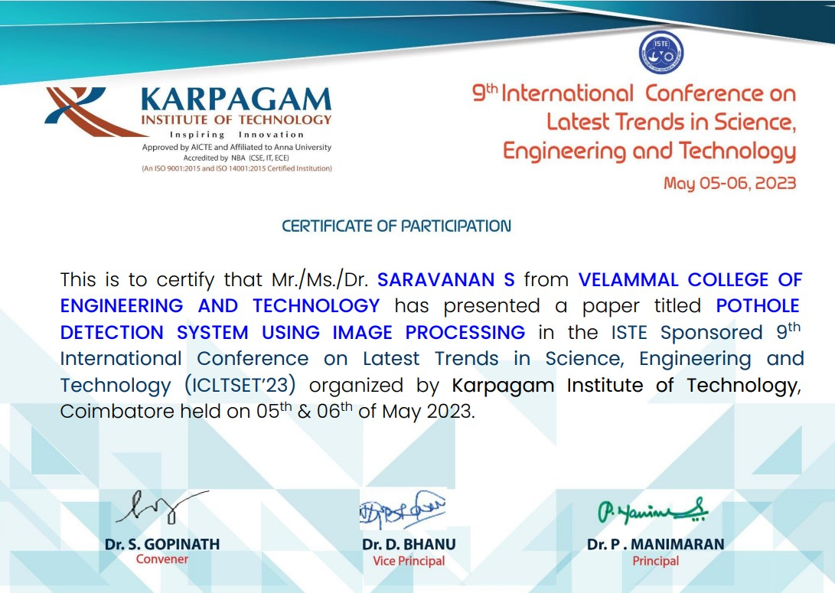
Publication Proof
Department of Computer Science and Engineering Final Review
Velammal College of Engineering and Technology 22- 05-2023

Slide 24

Publication Proof
Department of Computer Science and Engineering Final Review
Velammal College of Engineering and Technology 22- 04-2023

Slide 25

Publication Proof
Department of Computer Science and Engineering Final Review
Velammal College of Engineering and Technology 22- 05-2023

Slide 26
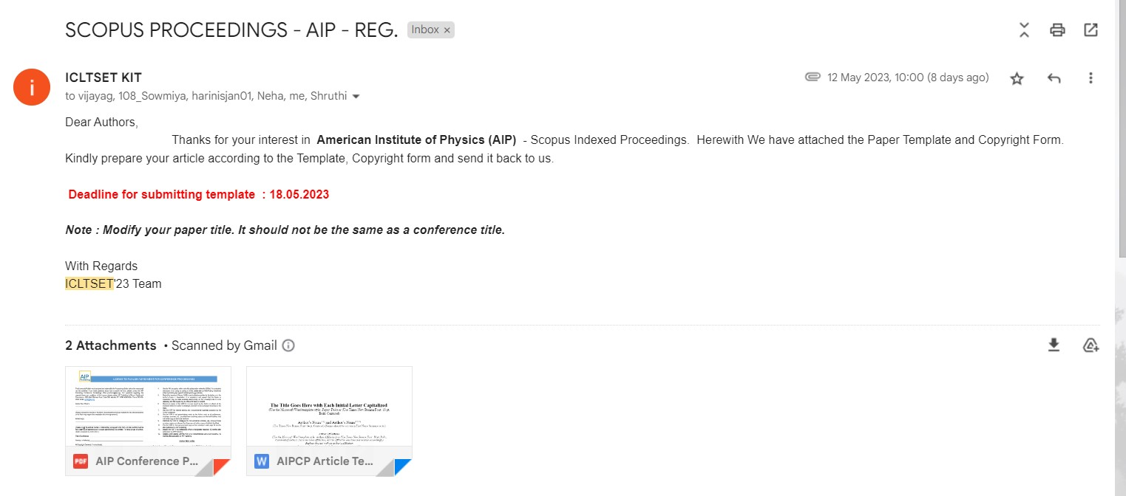
Publication Proof
Department of Computer Science and Engineering Final Review
Velammal College of Engineering and Technology 22- 05-2023

Slide 27
THANK YOU
Department of Computer Science and Engineering Final Review
Velammal College of Engineering and Technology 22- 05-2023

